Slide 1
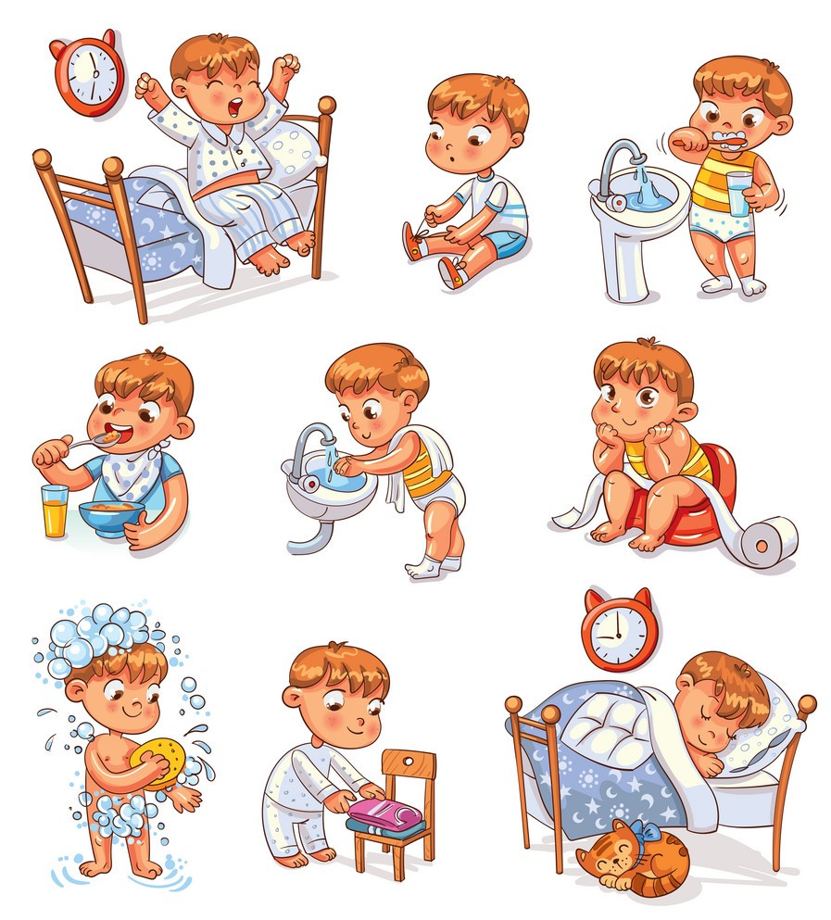
Grade 4
UNIT 6
Jim’s day
Lesson 1

Slide 2
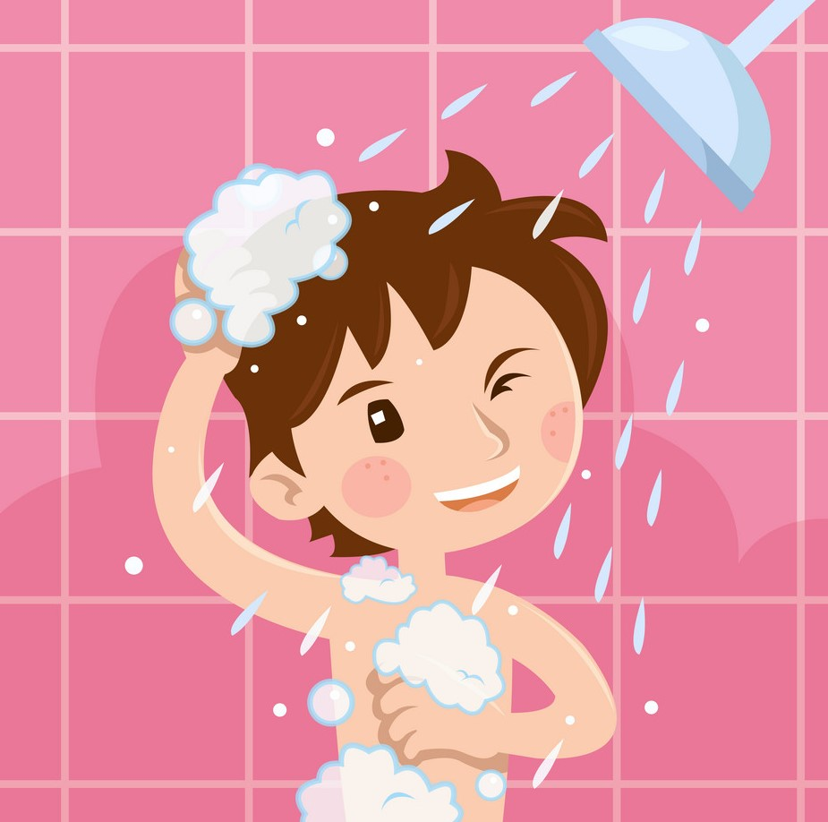
have a shower

Slide 3
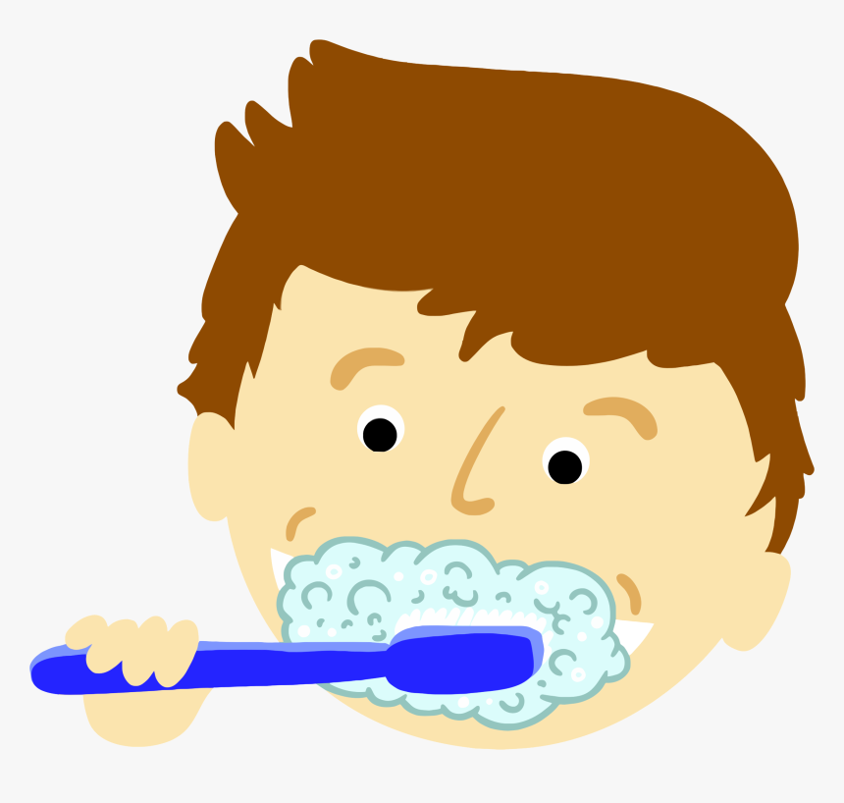
brush my teeth

Slide 4
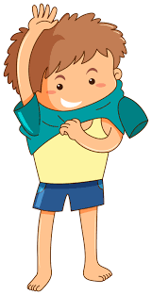
get dressed

Slide 5
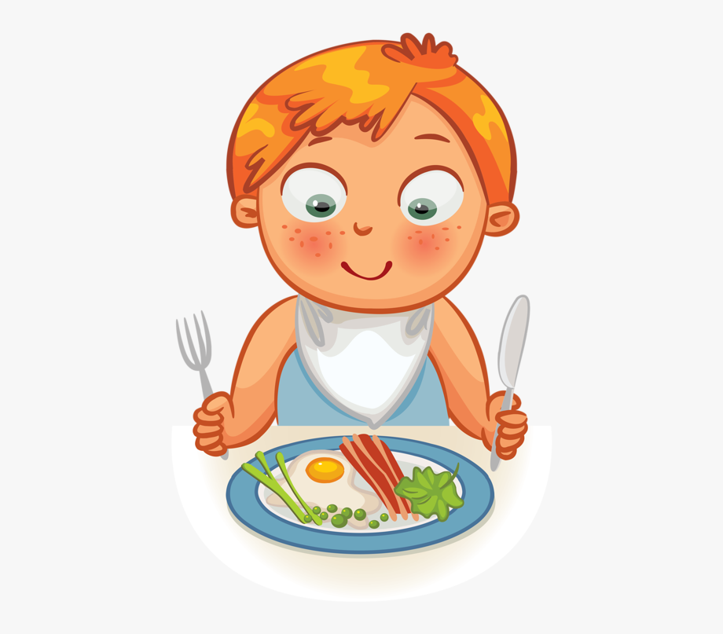
have breakfast

Slide 6
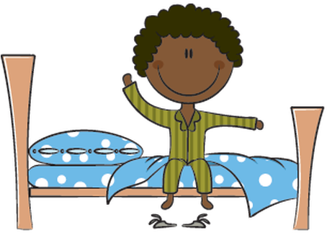
get up

Slide 7
catch the bus

Slide 8
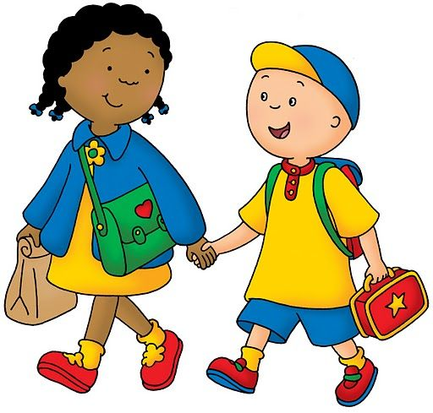
walk to school

Slide 9
Role play

Slide 10
Workbook time!!!

